Slide 1
Weekly update 5
Maxwell Mullin

Slide 2
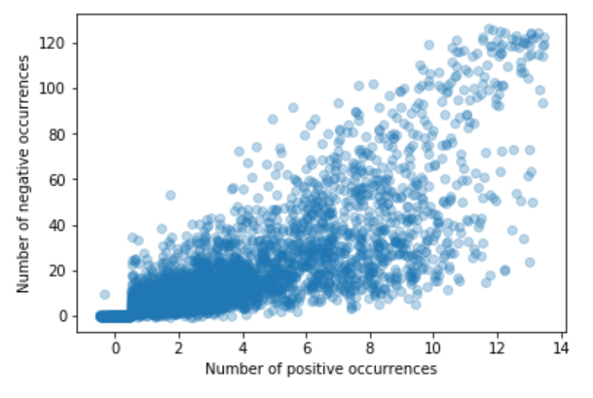
Double strand motif foreground vs background

Slide 3
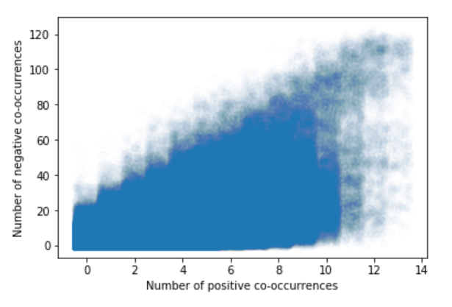
foreground vs background of Motif Co-occurance in double stranded data

